Slide 1


ThymeToCook
ITPV302 – Presentation
5 November 2024
Nathan Rogers s221412581
Zanele Mndaweni s225097524
Max Naidoo s225227053

Slide 2
Introduction
People struggle to find recipes that are suited to their needs
Lack of beginner-friendly recipes
How this affects those who need easy to follow recipes

Slide 3

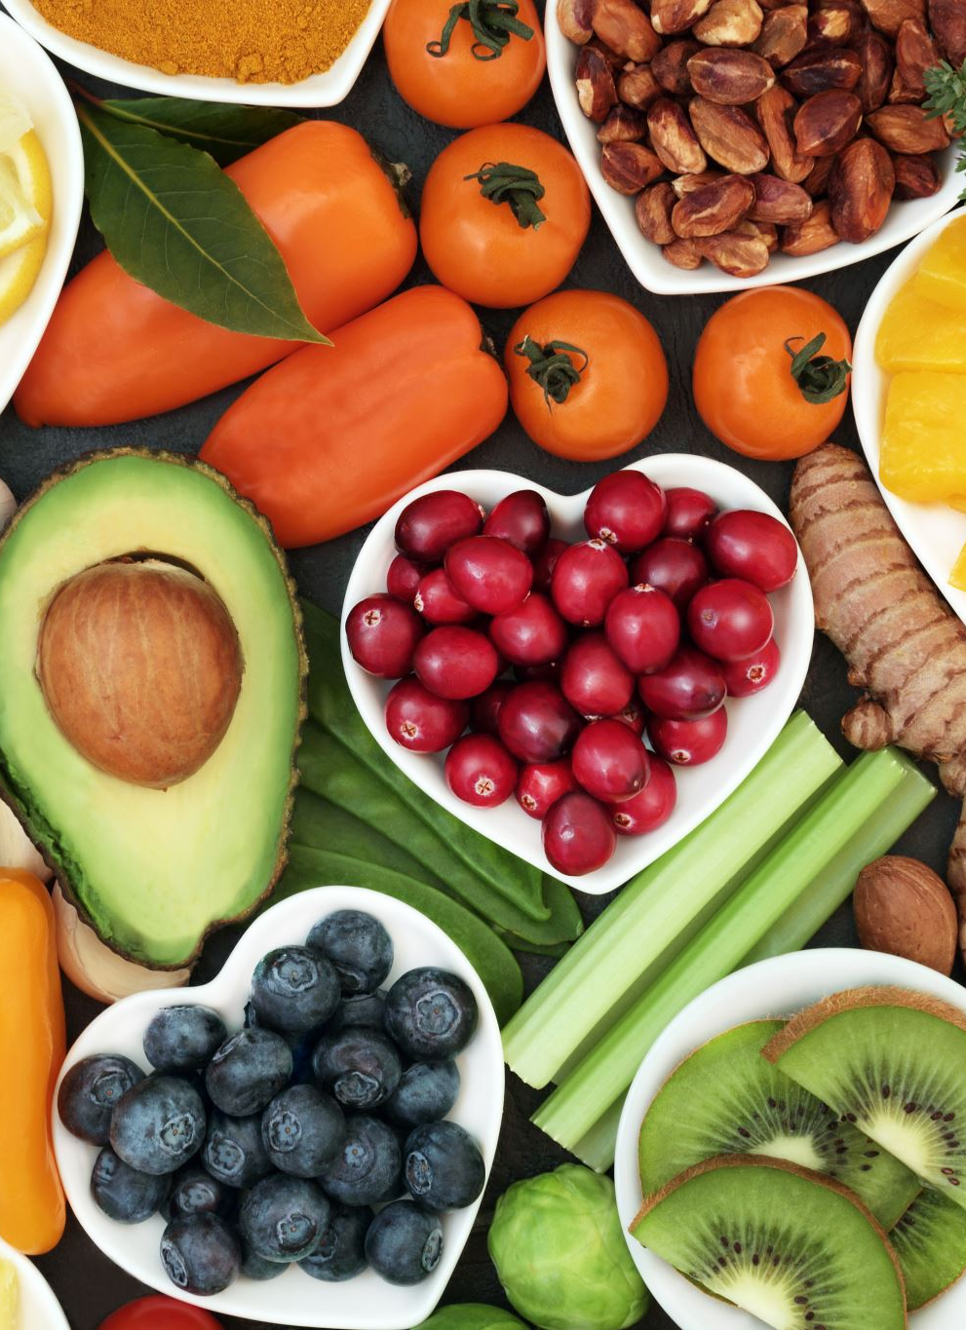
Objectives
Personalise meal plans
Filter recipes based off available ingredients
Offline feature to save recipes
Provide step-by-step instructions
Scheduling with a built-in meal planner
Cross Platform App

Slide 4

Requirements
Hardware
Software
Phone or tablet with minimum 2GB RAM
Web app requires stable internet connection
IDE - VS Code
Framework - Flutter (Version 3.24.2)
Dart (Version 3.5.2)
Firebase (Version 13.17.0)
Android 5 (minimum API/SDK 21)
Web browser (optimized for MS Edge)
Database hosted on the Firebase cloud infrastructure

Slide 5
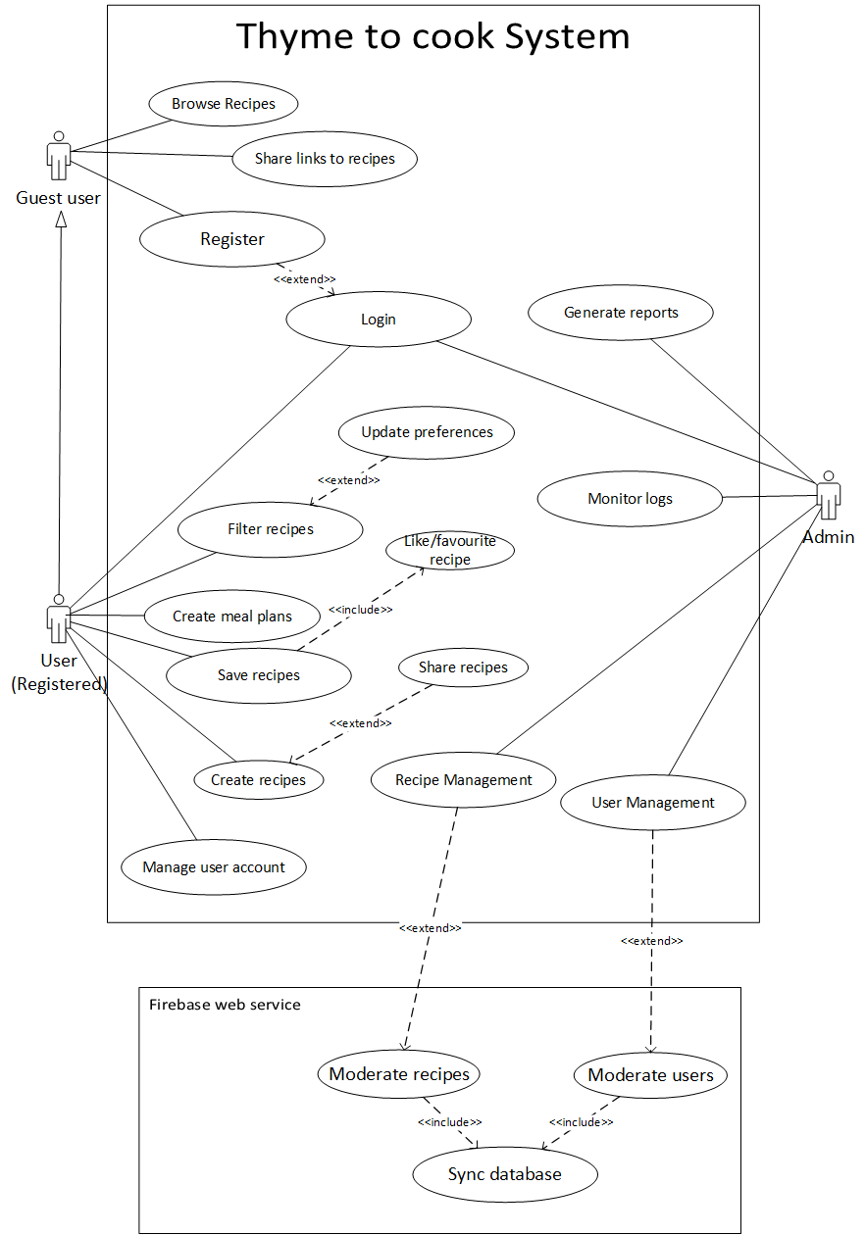
Use-case Diagram
Guest Users: Limited to features such as the browsing of recipes before registering
Registered User: Access to meal planner, grocery list, saving recipes
Admin: View analytics, manage recipes and users.

Slide 6
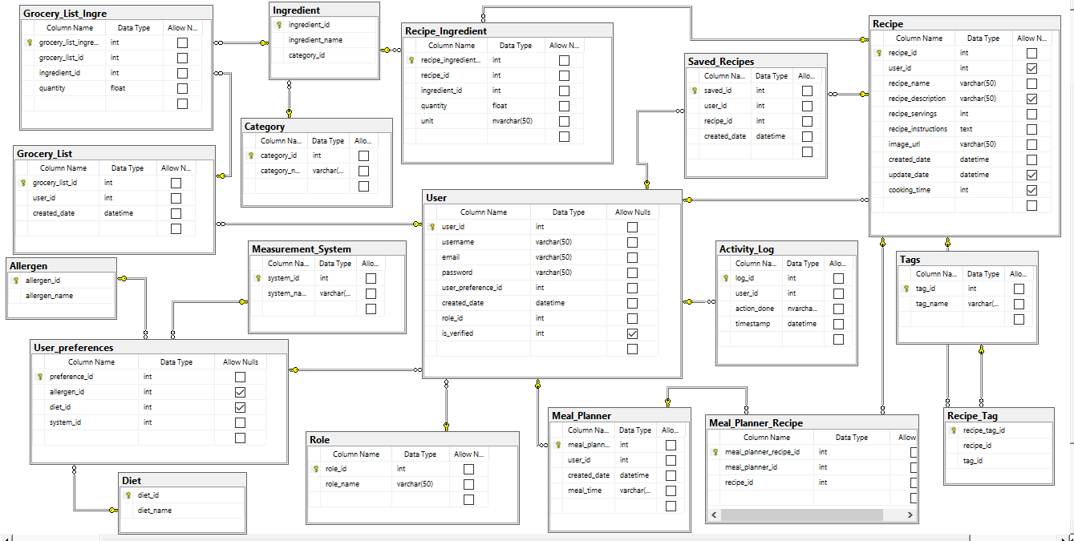
Relational database diagram
Database structure with Firebase
User and Recipe collection
Data syncing
Security and privacy

Slide 7
Relational database diagram

Slide 8
App demonstration

